Slide 1

Addressing Churn in GE’s Healthcare IT Service
A Data Analytic Solution
By Michael Surdek
Notes:
This presentation serves 3 purposes:
1) An identification of a business problem and potential solution regarding GE’s healthcare IT service
2) A report of the results of a pilot project undertaken to gauge the feasibility of the solution
3) A proposal for a full-scale project to implement the solution into GE’s business operations and strategy

Slide 2
Background
The Product
GE’s Healthcare IT application
- Assists medical professionals in their daily work
Customers are required to use:
- A GE-provided smartphone
- Coverage from their partner SmartAppCellular
The Problem
Recent increase in churn
Customer feedback indicates potential causes:
- Poor cellular coverage
- New vendors competing in the same space
Notes:
GE’s offers a healthcare IT service product that assists medical professionals in their daily work. To ensure proper bandwidth and support, the application must be used with a GE-provided smartphone that only includes coverage from their partner, SmartAppCellular. The service is tendered on a subscription basis and lately GE has experienced an increase in attrition, or churn. Based on customer feedback, this recent churn is related more to the cellular coverage than to the application and the product itself. Additionally, GE recognizes that new vendors are beginning to compete with similar offerings, and that, if they wish to maintain or strengthen their position in the market, they need to identify and resolve the problems that are causing customers to cancel their subscriptions.

Slide 3
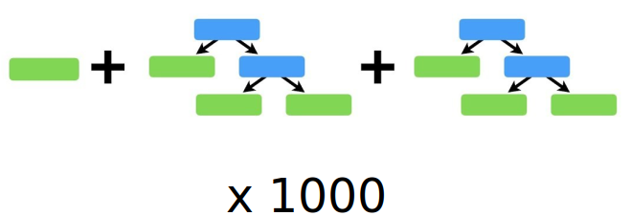
Analytical Tools & Structure
Objective
- Use data mining and analytics to understand the causes of churn and predict which customers are likely to churn
- Pilot project can reveal whether there are signals in the data that are worth pursuing with further investment
Tools
- R → programming language for statistical analysis and predictive modeling
- Integration with current CRM platform for customer service & active outreach
Methodology
- Binary classification
- Random forest (ensemble of decision trees) ----->
- Predicts whether or not a customer is likely to churn
Notes:
In order to provide business value through an advanced analytic project, information on current and past subscribers can be used to evaluate the likelihood that a given customer will cancel their subscription.
The main analytic tool to be used for research, modeling, and deployment in this project should be the statistical programming language R. R is a powerful tool that has the capability to handle large and complex data sources, extensions and transformations of the data, robust machine learning algorithms, and the integration of the model for business purposes. Additionally, with a tool such as R, GE’s data environment can be better leveraged to provide real-time and relevant insights.
There are many classification techniques including logistic regression, naive bayes, support vector machines, or tree based methods such as CART, random forest, and gradient boosting machines. Tree based methods have been shown to be excellent predictors of binary target outcomes, especially when applied through ensemble learning and/or boosting methods. Random forest is an ensemble of simple decision trees that makes a final prediction based on the majority of predictions from all of the separate trees. Feeding the available data into a random forest is a good fit for determining whether or not signals exist for predicting customer churn.

Slide 4
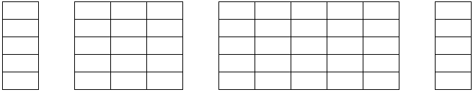
Data Source
Derived monthly from data warehouse
Sample data set contains 1000 observations of 84 fields
29 Fields
Usage/Coverage
51 Fields
Personal/Demographic
Target
Churned?
ID
Notes:
The data set that GE has compiled from their monthly reporting system is well suited for the purposes of building an analytical model to predict customers who are likely to churn. The sample data contains 1000 observations with 84 variables for each subscriber. There are approximately 30 fields that pertain to cellular coverage, equipment, and average usage patterns. The remaining fields include information on each individual such as family makeup, credit rating, occupation, and customer service history. Only 3 fields include categorical values, and the others are numeric, although some of these represent categories and are stored as binary numbers 1 and 0. In fact, 2 of the 3 categorical fields are labels for those binary variables just mentioned. Trial and error in the modeling phase can determine whether it is better to use the labels or the dichotomized values.

Slide 5
Additional Fields
Extending the Source
Usage data
- Total calls
- Percentage of dropped calls
Location data
- General region v area code
- Quality of coverage in region
External Data
Outgoing survey data
- Reasons for cancelling
- Switching providers?
Credit card
- From third party
- Specific card types/limits
Notes:
There are some additional data fields, not already in the given data set, that might be good indicators of customer attrition. Some of these potential fields can be derived from the given data, and may turn out to be better predictors than the basic fields from the source. For example, there are fields for inbound and outbound calls, but they could also be combined into a new field that represents the total number of connected calls. On the other hand, fields from additional data sources might also supplement the given data source. For example, there is a variable for whether or not the customer possesses a credit card, but it could be worthwhile to use a third party data source that contains the specific type of credit card that they own. This information can be hard to obtain, and may not even be useful in the final model, but additional data sources should absolutely be considered for this data mining project.

Slide 6
Ethical Implications
Certain data can be damaging, biased, or discriminatory
- E.g. gender, race, nationality, zip code
Information should only be available when it is:
- Relevant
- Acceptable
- Professional
Predictive inputs and outreach strategies must maintain customer equality, privacy, and confidentiality
Notes:
There are certain ethical implications that can arise from using a dataset like the one available to try to predict customer behavior. Some potentially damaging fields might include gender, race, or nationality. Use of these fields in a predictive model can promote bias and discrimination if the data set is skewed or misrepresentative of the bigger picture.
Another cause for concern is determining how to maintain privacy and confidentiality through the use the predictive model. For example, a drop in income or a divorce might be good predictors of customer attrition, but it would not be good practice to approach someone in these positions pleading for their business
It will be important to accurately estimate the likelihood that a customer will cancel, but it will be equally important to ensure that the business to consumer relationship remains professional and respectful.
If the reason for a high churn probability is something personal in nature and outside the scope of the typical business to consumer relationship, GE must accept the potential loss and move on to customers who can be serviced in a more traditional fashion.

Slide 7

Pilot Model Creation
A very simple model trained on a subset of the source data:
Builds 100 decision trees by randomly sampling 6 variables at each node and using the best predictor of customer churn
Let’s see how it performs….
Notes:
A random forest model can be easily created in R by simply setting the number of trees to create and the number of variables to randomly sample at each node.

Slide 8
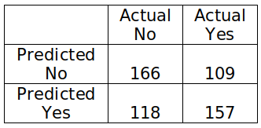
Results
Predictions
Overall accuracy: 59%
Most Important Variables
For predicting Yes:
Change in minutes
Equipment days
Off-peak calls
For predicting No:
Average monthly minutes
Recurring charge
In/out bound calls
Notes:
Looking further into the results of the random forest model reveals that it can predict customers who will churn with an overall accuracy of approximately 59%. The confusion matrix shows that it can correctly predict 57% of customers who have churned and 60% of those who have not.
Another key output from the results of the model is variable importance, which is measured as the mean decrease in prediction accuracy from including each variable. This list shows the top 10 most important variables in the model, and these will be critical to improving the model further and understanding the true causes of customer churn. Some of the most important variables from the pilot model are change in minutes, equipment days, monthly revenue, and inbound calls.

Slide 9
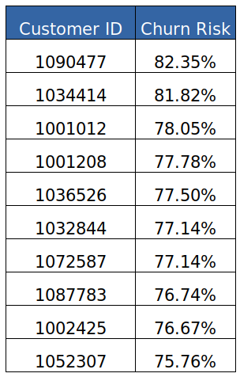
Full Implementation
Beyond the pilot project:
Improving predictive accuracy
- Up to 65-70%
- More complex model (logistic regression)
- Curated inputs
Testing the effectiveness of proactive
identification and outreach
- Contact 50 of the 100 most likely to churn customers
- Compare the number of cancellations between the
50 contacted and the 50 not contacted
Notes:
The value that GE can gain from utilizing a model to predict customer churn depends on the evaluation of two separate hypotheses. The first is whether it is possible to predict customer churn based on cellular service, usage, and personal information and the second is whether contacting customers when they are deemed likely to churn will save some of them from cancelling. The results of this pilot study confirm that it is reasonable to accept the first hypothesis, as a minimally complex model can predict churn at a significantly better rate than random guessing. Full pursuit of this project should only improve these results.
To evaluate the second hypothesis, the 100 customers can be split into a test group that is contacted by customer service and a control group that is left alone. If the accuracy of the model is as we expect, 35 of 50 customers from the control group will churn. For the test group, the difference between 35 and the number of actual cancellations that they observe is half the amount of customers per 1,000 that can be expected to be saved by proactive outreach based on the predictive model. For example, if there are only 25 cancellations in the control group, then it makes sense to say that they could have saved 20 customers out of the 1,000 originally sampled and the 100 who were identified as likely to churn.

Slide 10
Estimated Value
Assumptions:
Subscriber base = 50,000
Proportion likely to churn = 1 out of 10
Model accuracy = 70%
Proportion savable = 2 out of 7
Average monthly revenue = $58
Full implementation can save $58,000 of recurring monthly revenue
Notes:
Based on an average monthly revenue from the data of approximately $58, preventing 20 cancellations would save $1,160 of recurring monthly revenue per 1,000 customers.
If GE has 50,000 active subscribers to their service, undertaking full implementation of this project can result in saving $58,000 of monthly revenue. This estimate depends on the size of GE’s subscriber base (50,000), the accuracy of the model (70%), the proportion of customers that it predicts as likely to churn (10%), and the percent of those that can be saved by proactive outreach (28%). If any of these factors turn out better than what seems most probable at this time, GE will only realize more value from this approach.

